Slide 1
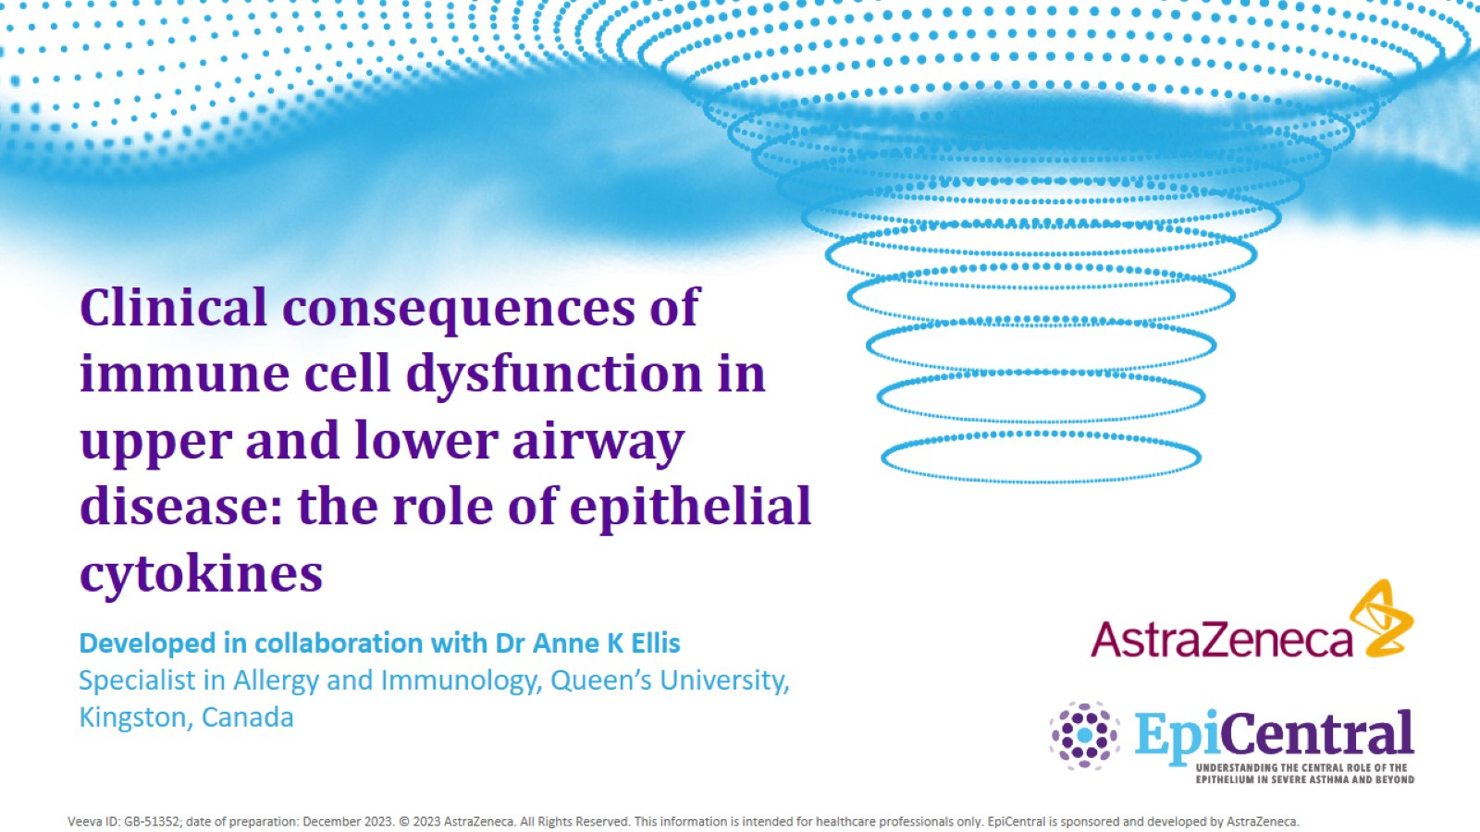
Clinical consequences of immune cell dysfunction in upper and lower airway disease: the role of epithelial cytokines

Slide 2
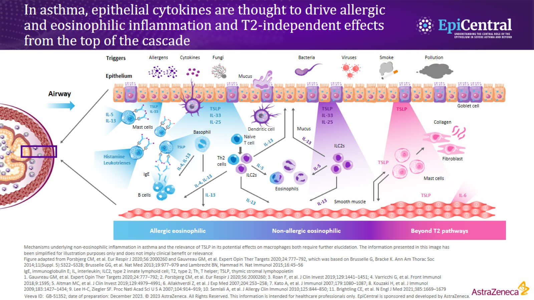
In asthma, epithelial cytokines are thought to drive allergic and eosinophilic inflammation and T2-independent effects from the top of the cascade

Slide 3
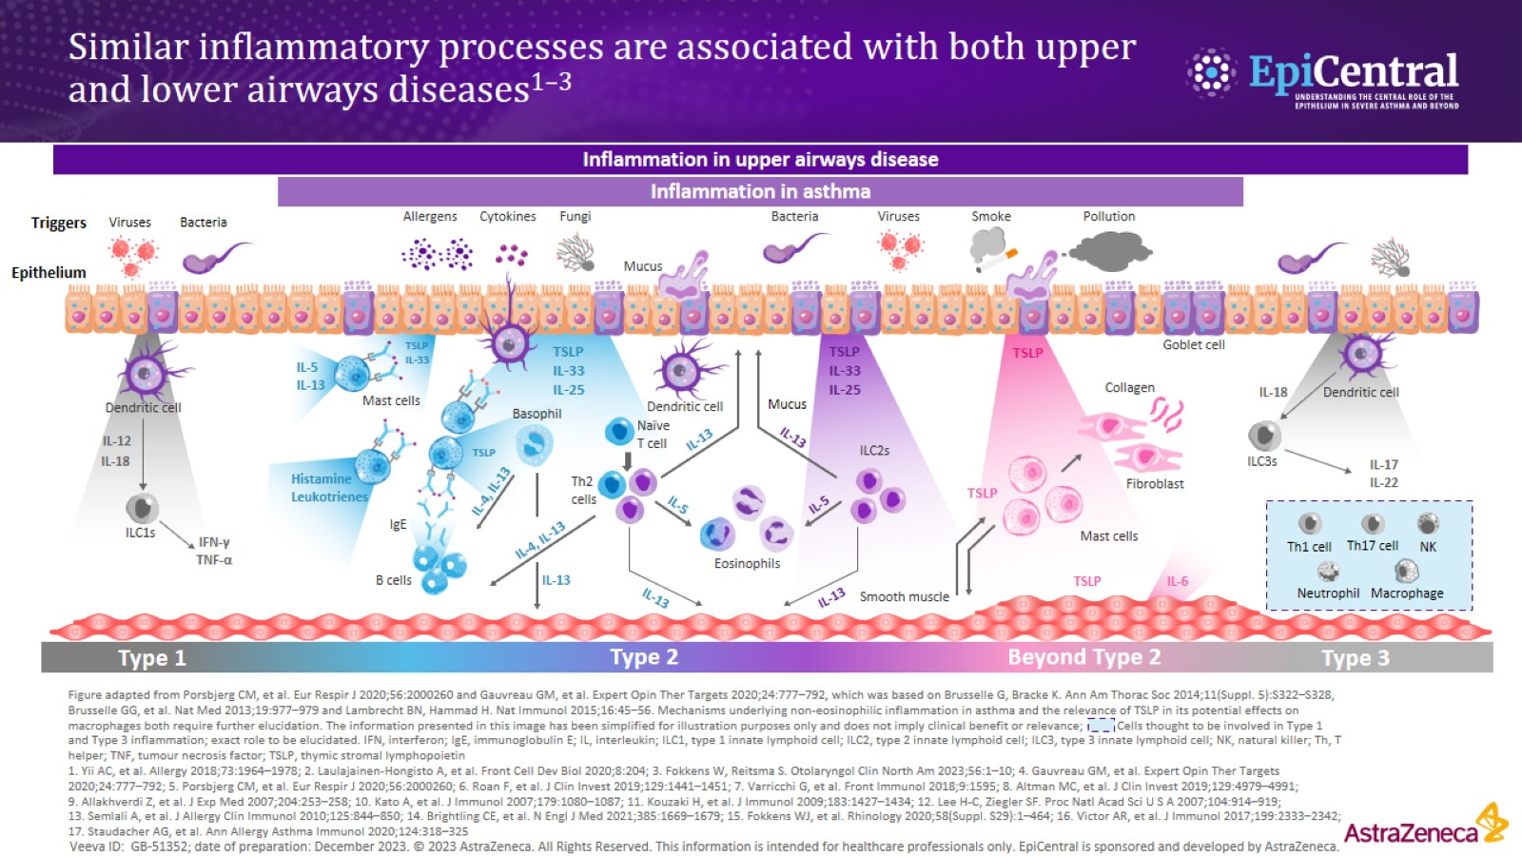
Similar inflammatory processes are associated with both upper and lower airways diseases^{1–3}

Slide 4
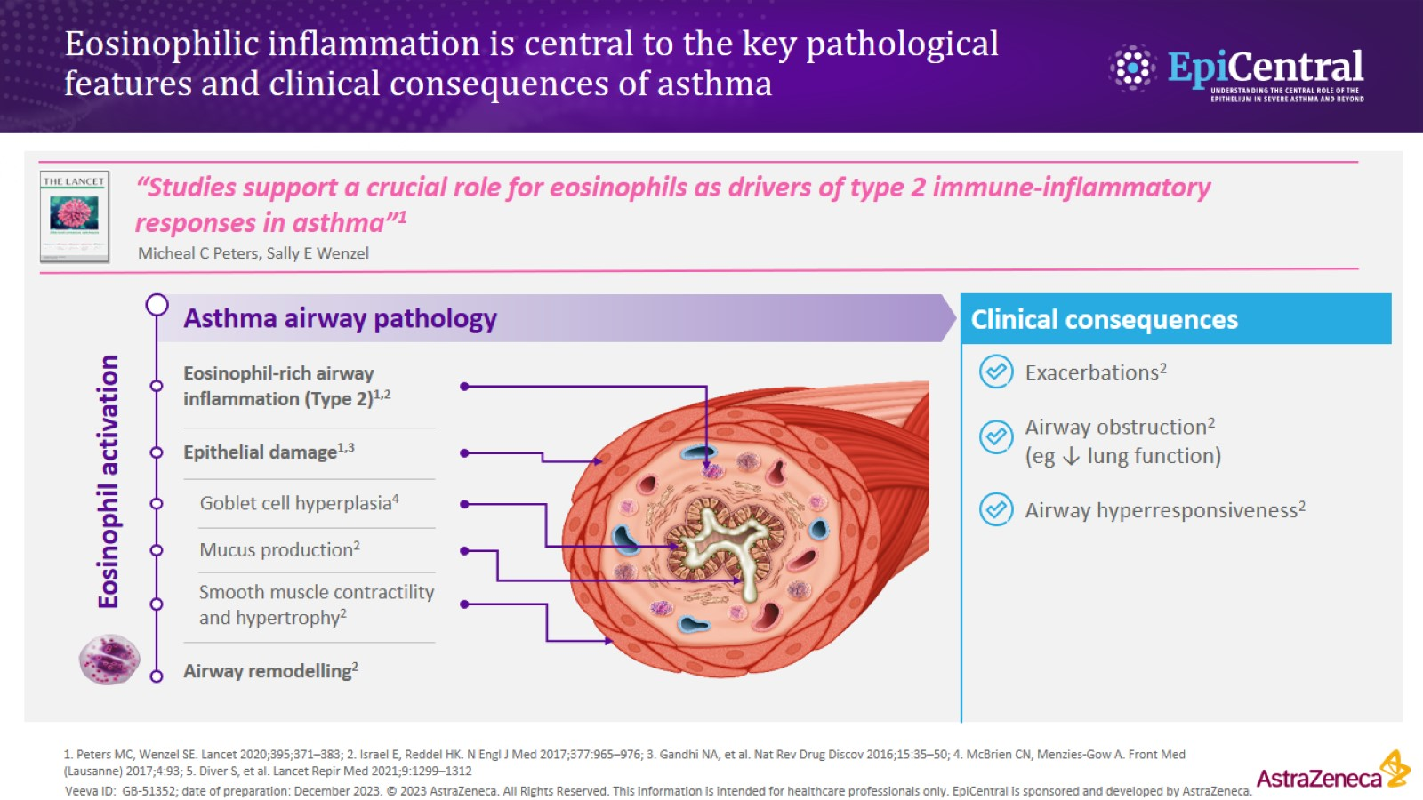
Eosinophilic inflammation is central to the key pathological features and clinical consequences of asthma

Slide 5
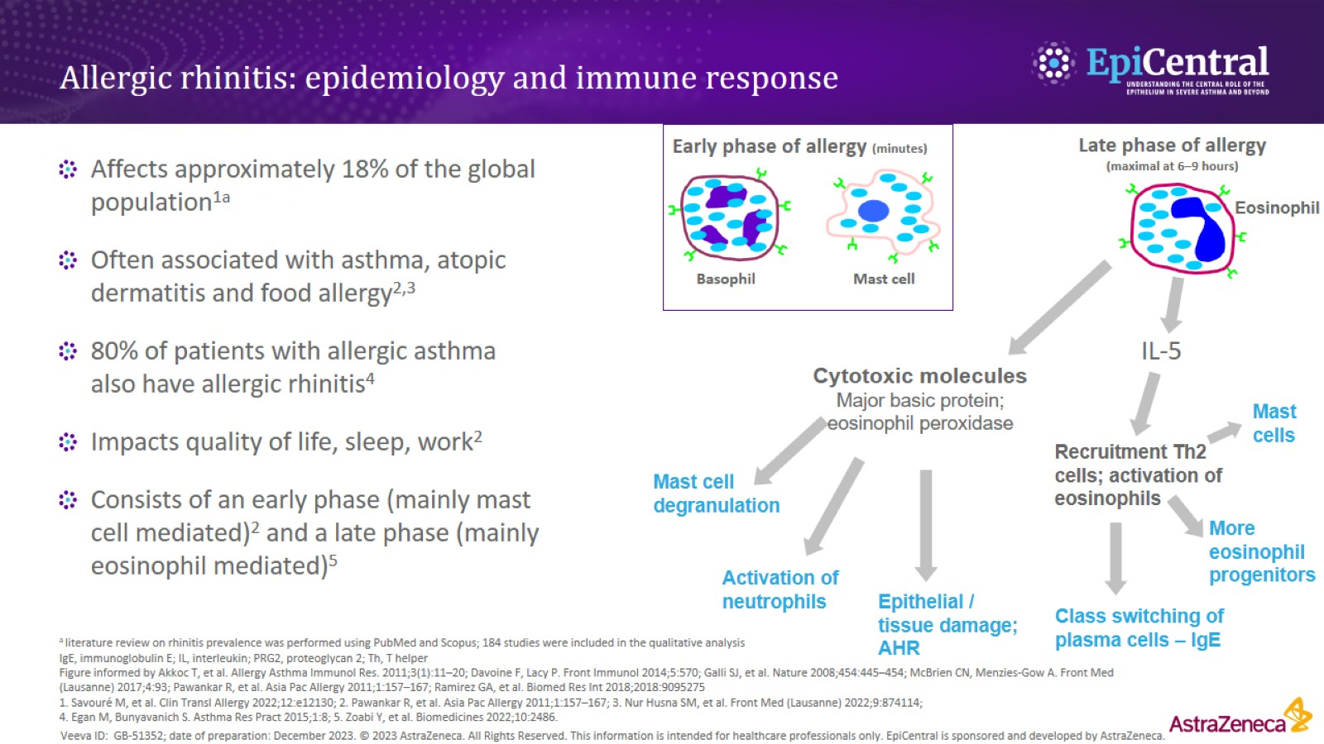
Allergic rhinitis: epidemiology and immune response

Slide 6
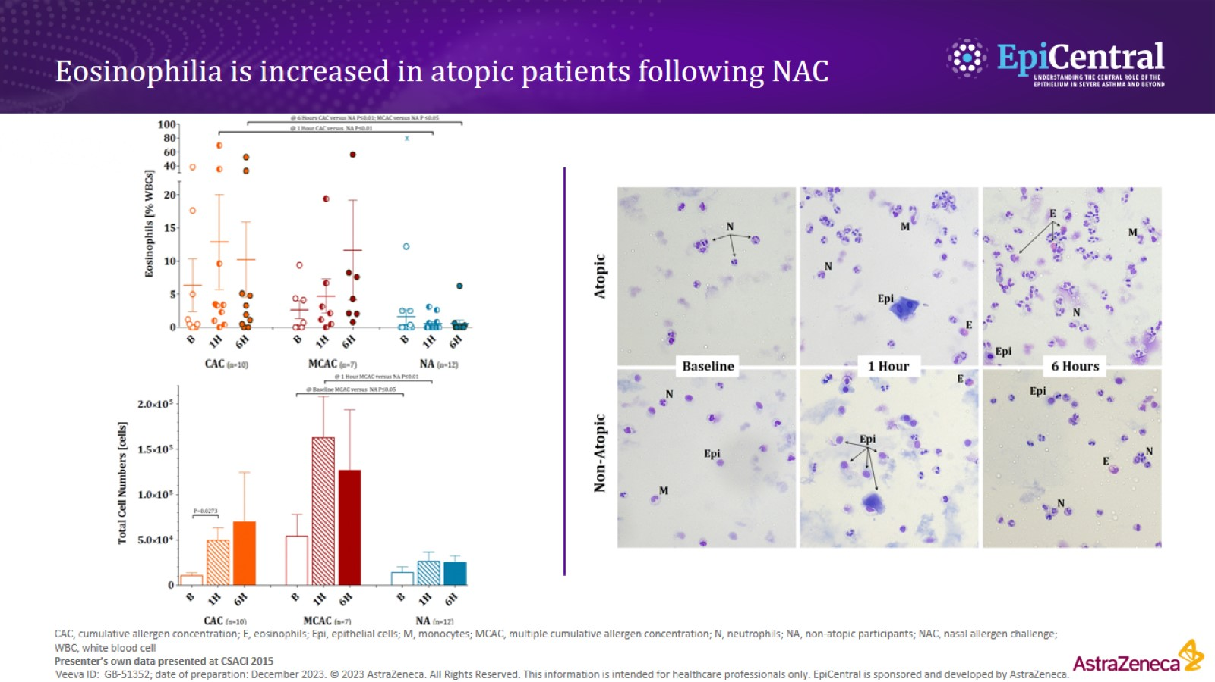
Eosinophilia is increased in atopic patients following NAC

Slide 7
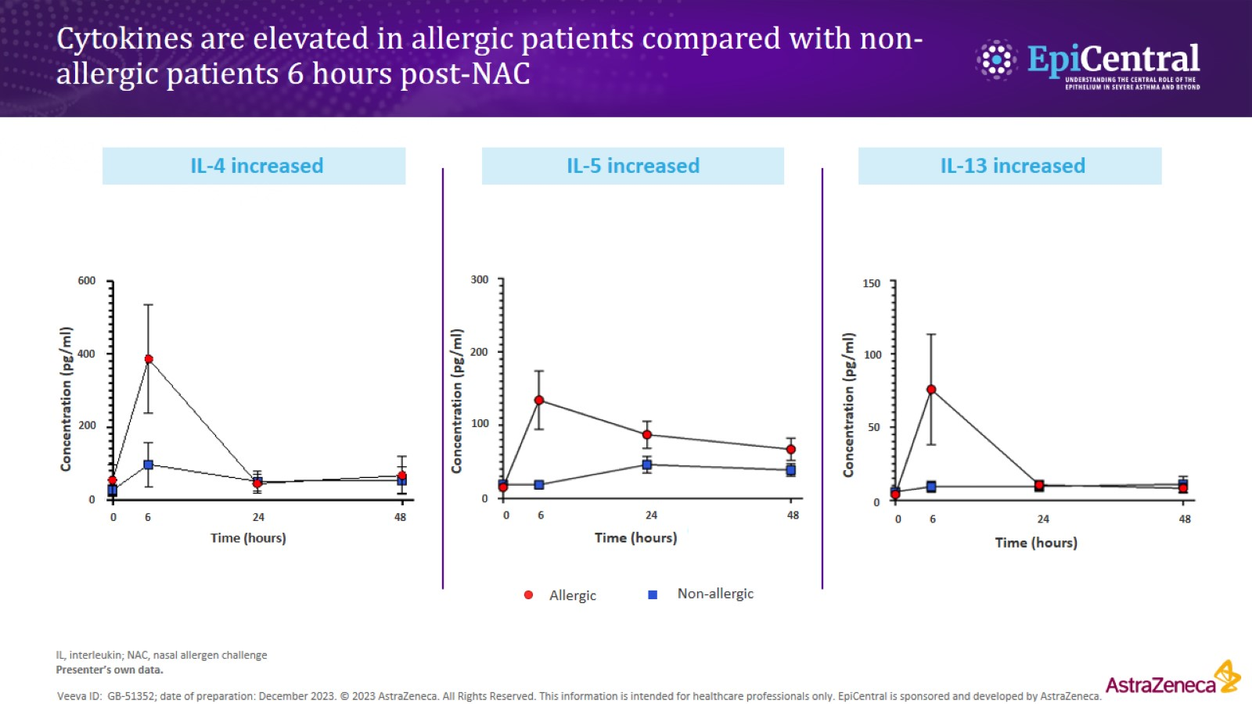
Cytokines are elevated in allergic patients compared with non-allergic patients 6 hours post-NAC

Slide 8
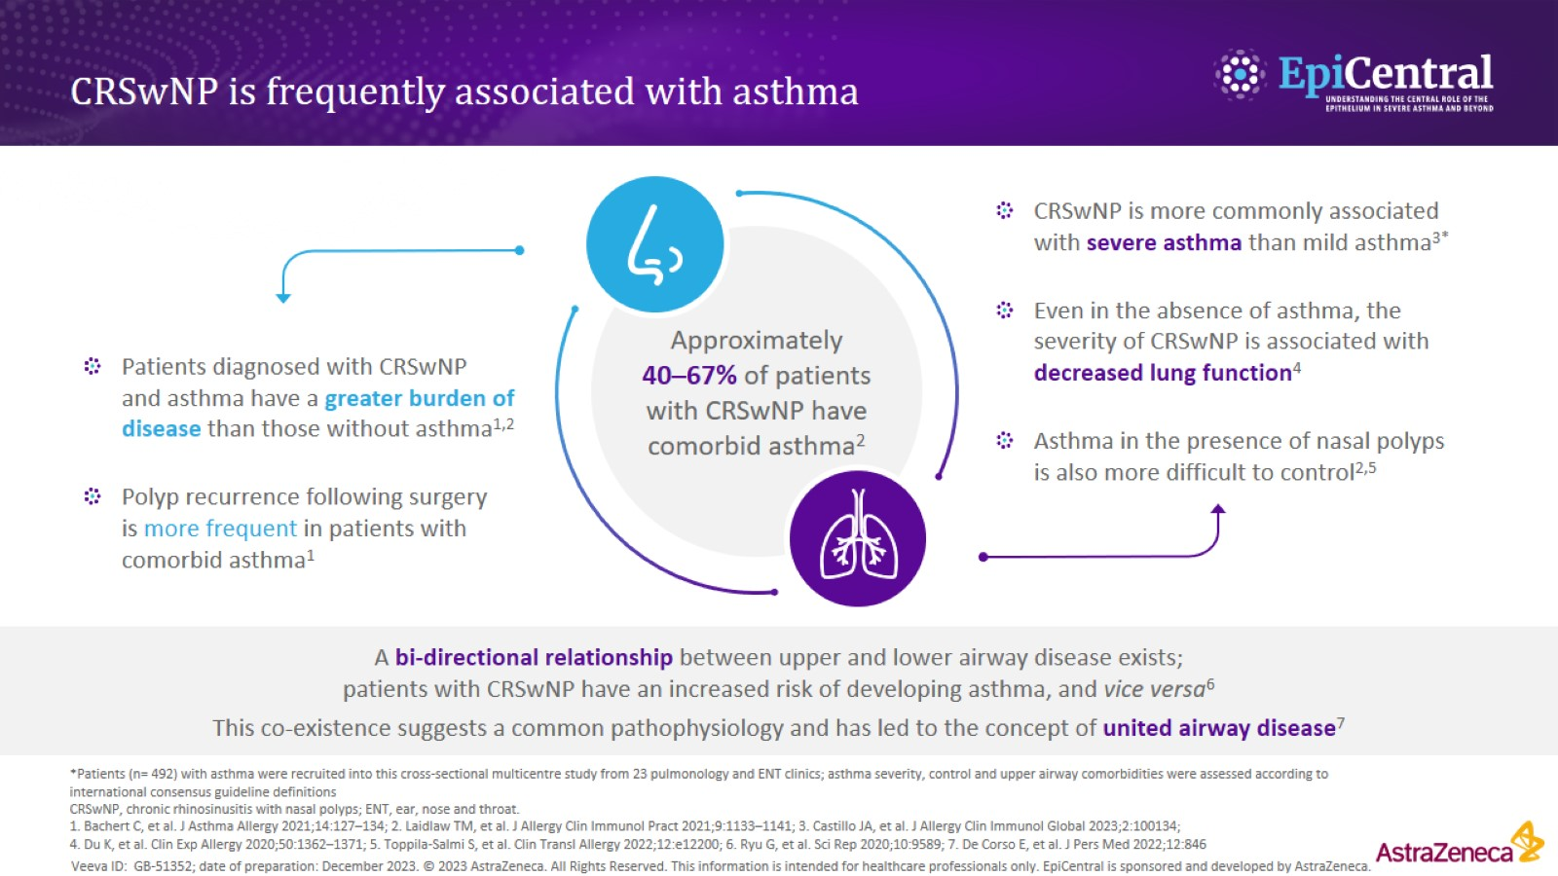
CRSwNP is frequently associated with asthma

Slide 9
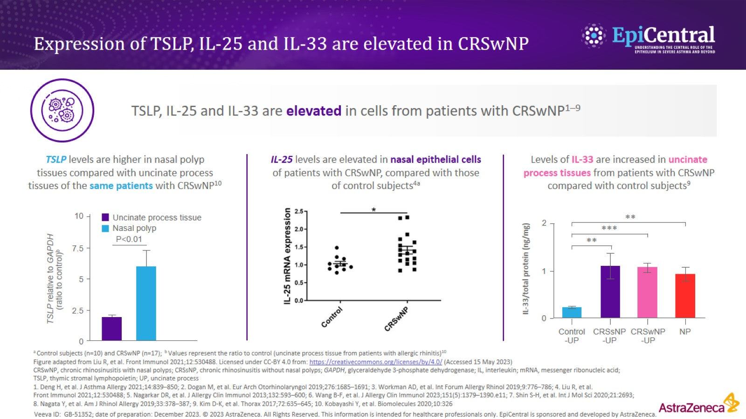
Expression of TSLP, IL-25 and IL-33 are elevated in CRSwNP

Slide 10
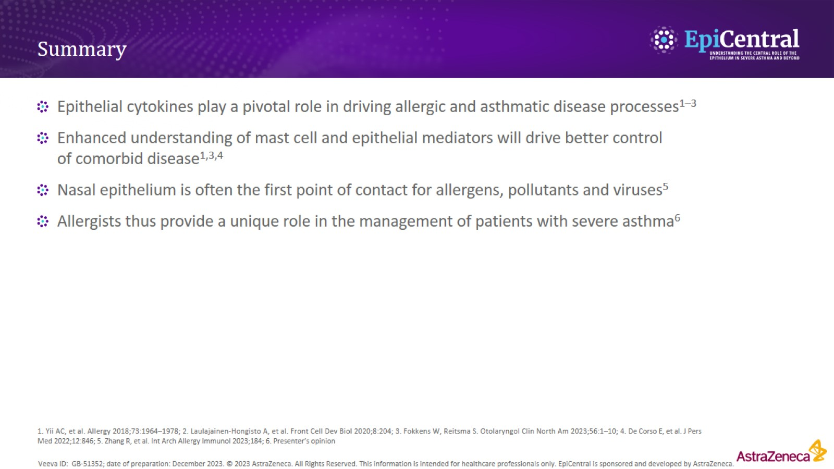
Summary

